Slide 2
IoT for Beginners and IT Pros
Kishore Chowdary,
C-Sharp Corner MVP,
Lead Training Associate,
CodeSizzler.
Twitter - @kishore_1702

Slide 3
Objectives
What is IoT?
Understanding the working of IoT.
Real-time usage of IoT.
Types of IoT devices.
Deploying an IoT solution.

Slide 4
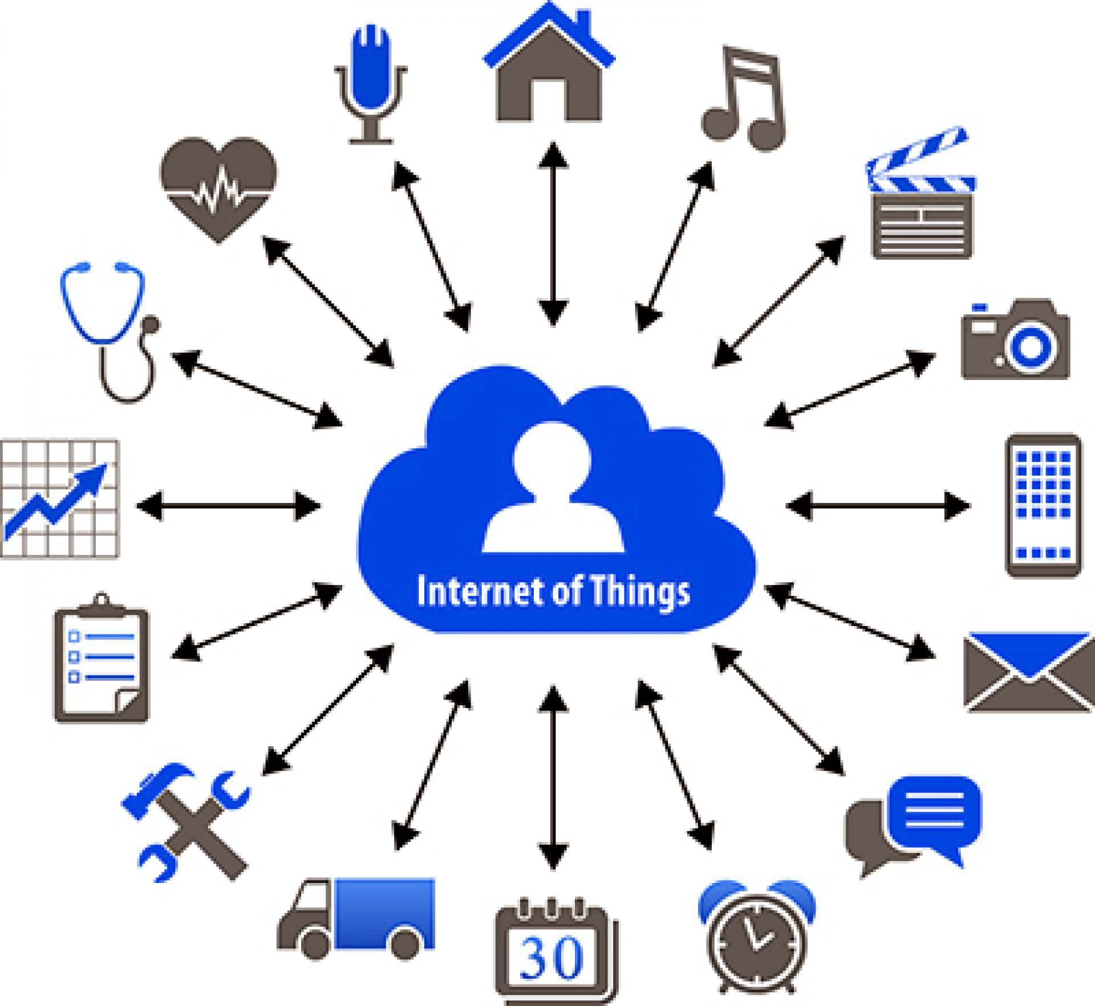
What is IoT?

Slide 5
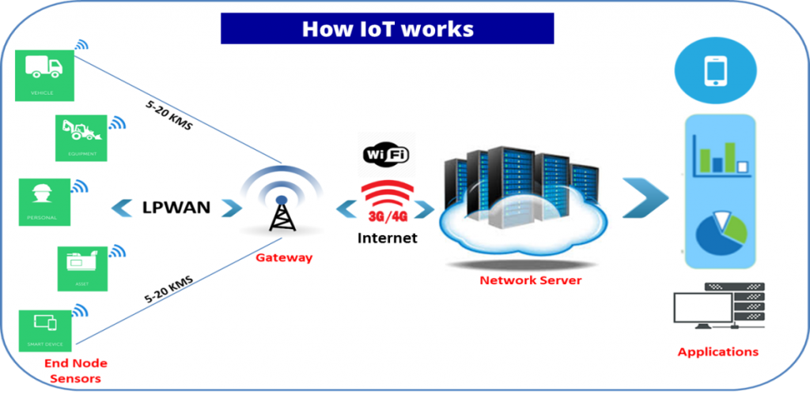
Working of IoT

Slide 6
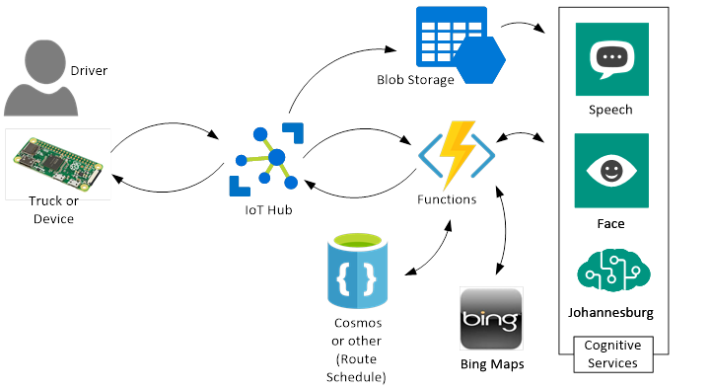
IoT Usage in Real-time

Slide 7
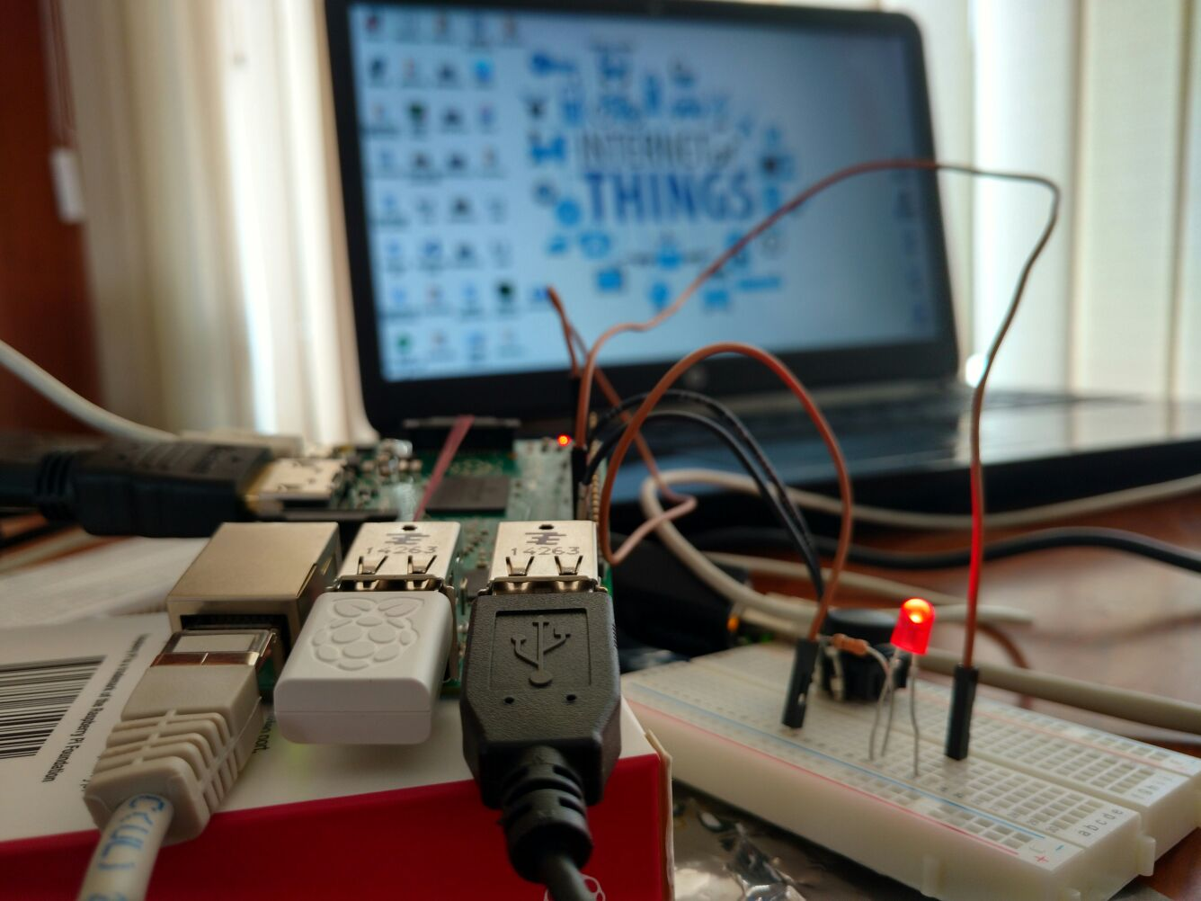
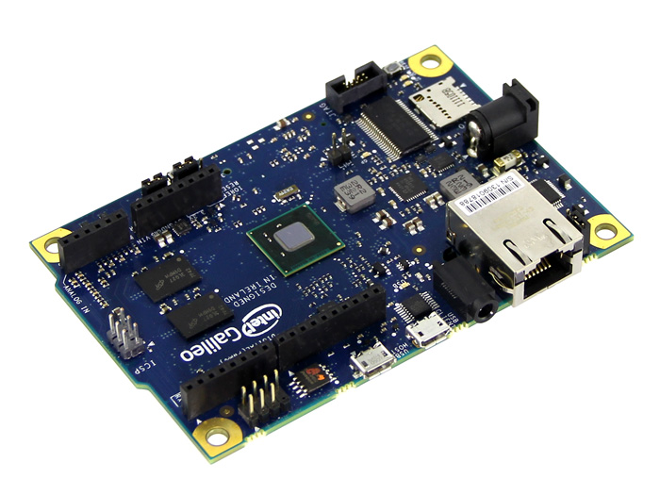
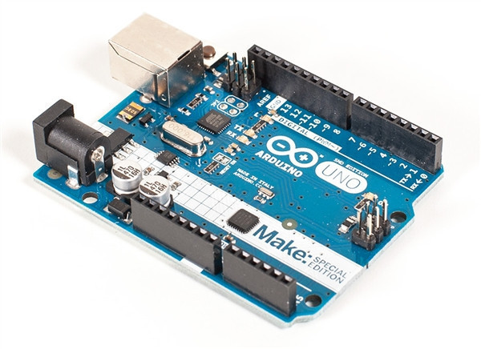
IoT Device Types

Slide 8
Demo – Deploying real-time solution using Raspberry Pi

Slide 9
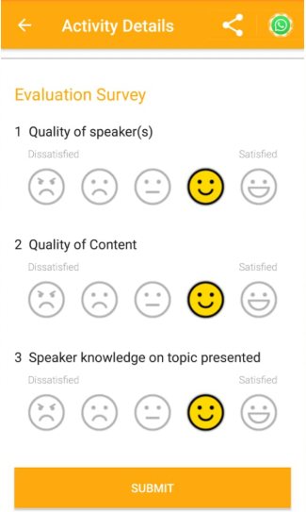
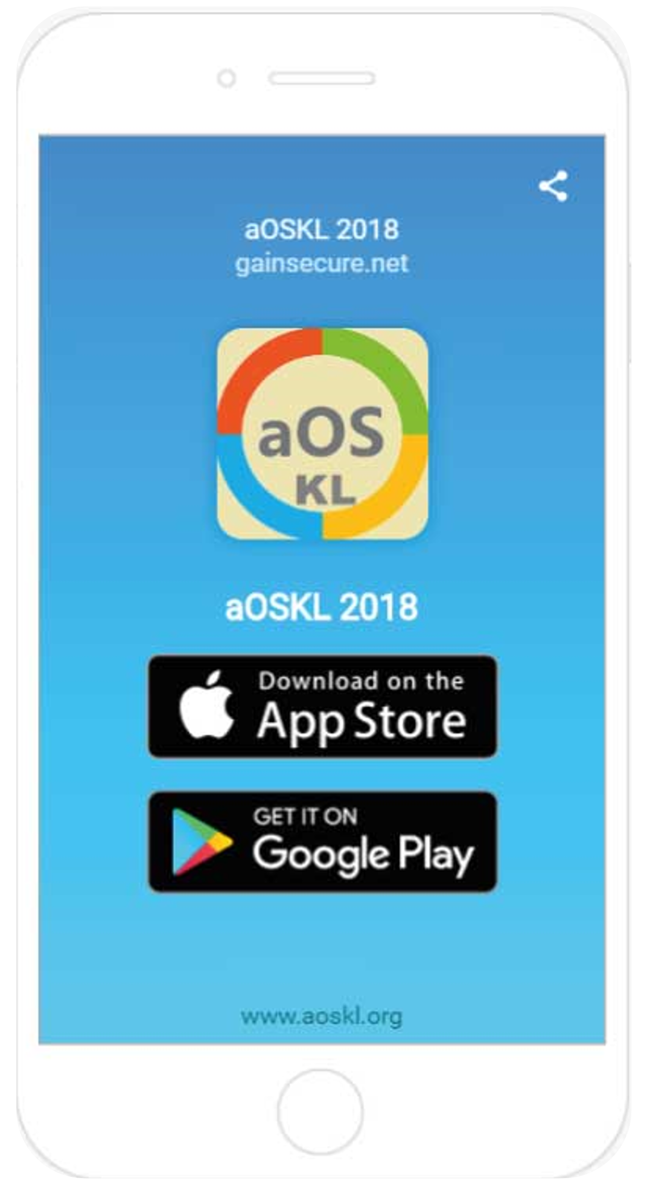

THANK YOU !
Please give us your feedback ☺
Rate each session with our
aOSKL 2018 Apps

